Slide 1







Market research
DolphinGroup

Slide 2

Executive summary
Problem
Read lots of separate resources
Inefficient note-taking and resources organization
Lack of personalization
Difficulties when reviewing those notes
Target audience
High school/university student
Office worker
Learner
Age: Gen X – Gen Y
Hobbies: learning, reading, researching
Solution
A hybrid-app can:
+ Read document file and take note in app
+ Organize notes in a structured and coherent manner
+ Create personal notebook to review, track progress and measure results
USP
Built-in note taking and intelligent organizing system
Integration with other tool
Less time-consuming for management
Goal
Positively impact people's behavior and study habits
Improve individual’s productivity, make learning effortless
Become top effective working and learning solution-providers

Slide 3
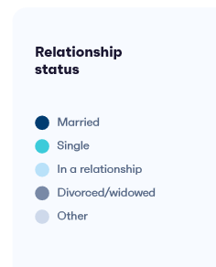


DolphinGroup
AGENDA
EXECUTIVE SUMMARY
SURVEY REPORT
Summary
Hightlight insights
Preliminary conclusions
MARKET UNDERSTANDING
Overview
Market trend
Customer Segmentation
COMPETITORS
Conclusions
SWOT analysis
Q&A
Ending

Slide 4





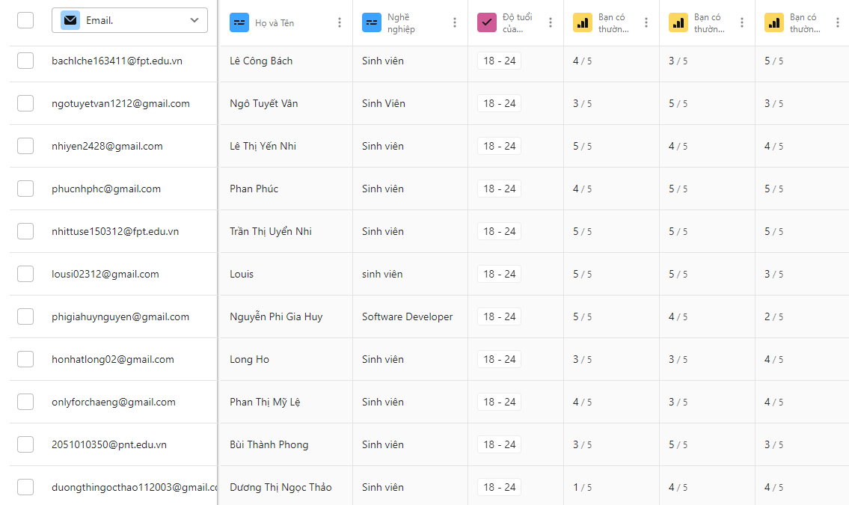
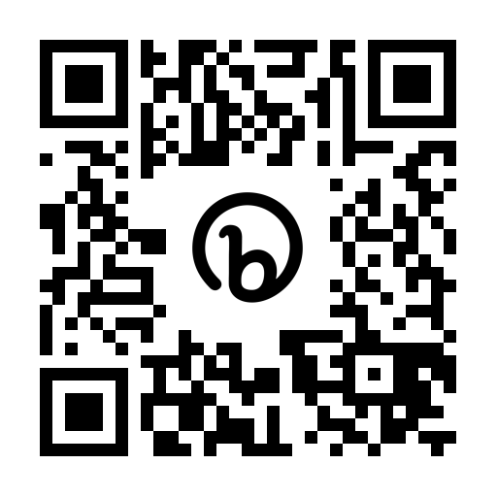
Survey report
Total views
Total Submissions
Valid Submissions
Completion rate
314
126
116
58.6%
bit.ly/tetu_report
Notes:
Simples is best, less is more

Slide 5
Align with the former stated context & problems
Traditional
5.2%
Digital
22.4%
Hybrid
72.4%
Note-taking demand
Feeling overwhelmed
Note-taking habits & overwhelming information problems
Note-taking methods
- Tetu survey report
Notes:
Simples is best, less is more

Slide 6
40.9% and 32.8% for interested and very interested
Self-assessment of process effectiveness
4.0
3.3
5
5
Interest of effective learning process
Average personal
effective score
4.2
Top 3 difficulties
5
Lots of movement and devices to deal with
46.6%
Managing and retrieving notes
44%
Lack of formatting and visualizing abilities in notes
42.2%
The need of a truly optimal solution
to support the learning process
- Tetu survey report
Notes:
Simples is best, less is more

Slide 7
Brand awareness in the related domains
1 - Don't know, don't use
3 - Know, rarely use
5 - Know, generally use
 | 1 | 2 | 3 | 4 | 5
Notion | 18.6% | 7.6% | 29.7% | 14.4% | 29.7%
Evernote | 53.4% | 11% | 27.1% | 6.8% | 1.7%
Obsidian | 65.3% | 11% | 16.1% | 6.8% | 0.8%
OneNote | 18.6% | 11.9% | 39.8% | 16.9% | 12.7%
AppleNotes | 33.1% | 8.5% | 27.1% | 20.3% | 11%
GoogleKeep | 30.5% | 7.6% | 25.4% | 24.6% | 11.9%
Notes:
Simples is best, less is more

Slide 8







Preliminary conclusion
Extensively reading and jotting down
Leverage both physical and digital method
Great interest in personal productivity
“
Avid learners with balanced note-taking methods
and moderate-high interest.
Demand for a all-in-one yet simple solution
Impact factors when choosing an app
User interface
”
Synchrony, connectivity
Cost
Personalization
Organization level

Slide 9
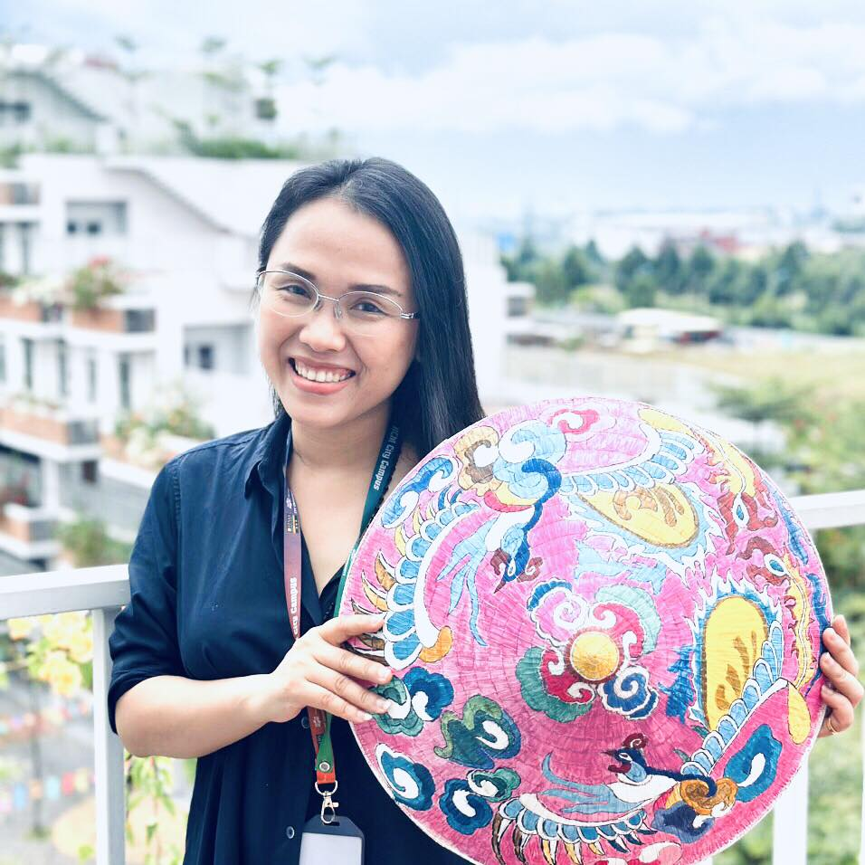



Customer understanding
Behaviours
Regularly read books, do research on a topic, and make notes.
Use pdf reader software on your computer and make notes in Word
Difficulties
Have to tab back and forth
Manage pages
Many many distributed notes
Mrs. Minh Hue Ng
FPT University lecturer
Needs
Ho Chi Minh City
- Ability to work offline of document management applications, automatically syncing when connected
- If highlighted, it will save the page number, author and book information
Master in Theory and History of Art- HCM University of Fine Art
“I want an app that can take notes directly on a pdf and then output a summary page.”
Notes:
Simples is best, less is more

Slide 10
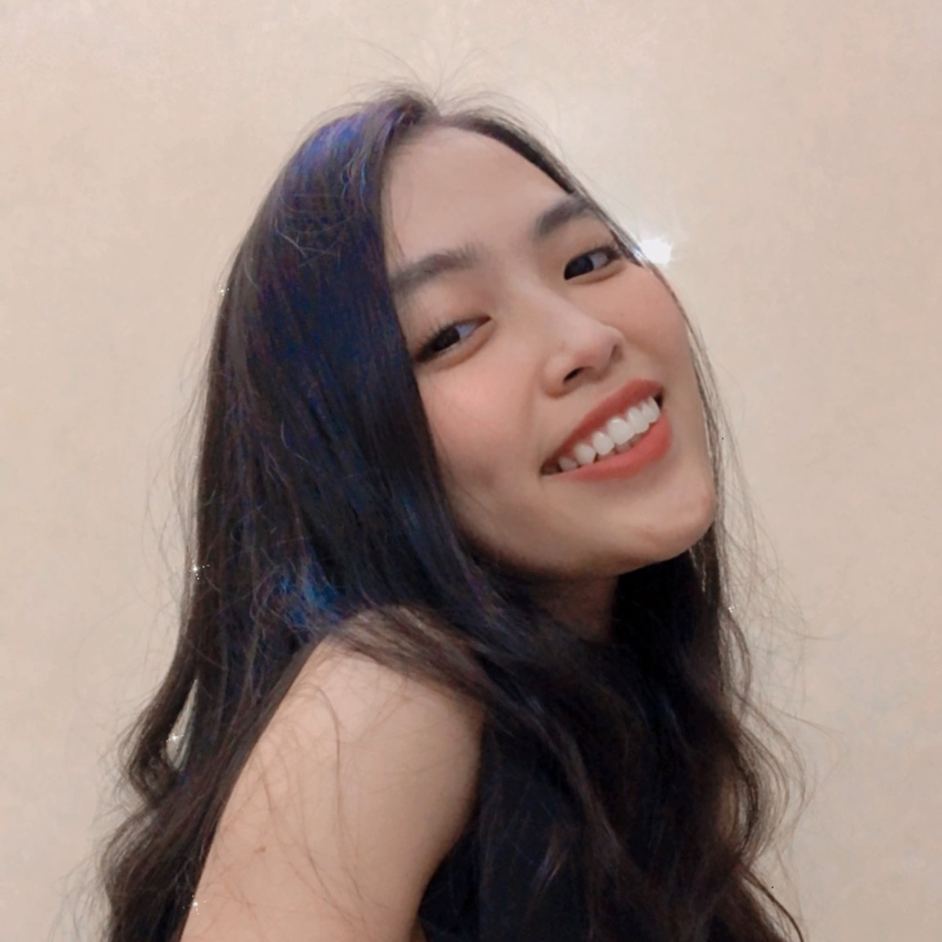

Customer understanding
Behaviours
Often read specialized material provided by the instructor, which can be hundreds or thousands of pages.
Use tablet to read the file and make notes directly on it
Difficulties
Lots of resource and files to manage
Low speed when taking note by typing
Fucnctionality of her productivity app are quite inconvenient when it come to Macbook, Iphone
Ms. Bich Ngoc
22 year-olds
Needs
Former Partnership Intern at Amanotes
- New way to interact and note when she have to use laptop
Miami, USA
Freshman at Miami University
“I feel that the current process is smooth and effective,
I appreciate writing notes by hand whether on paper or on a tablet.”
Notes:
Simples is best, less is more

Slide 11
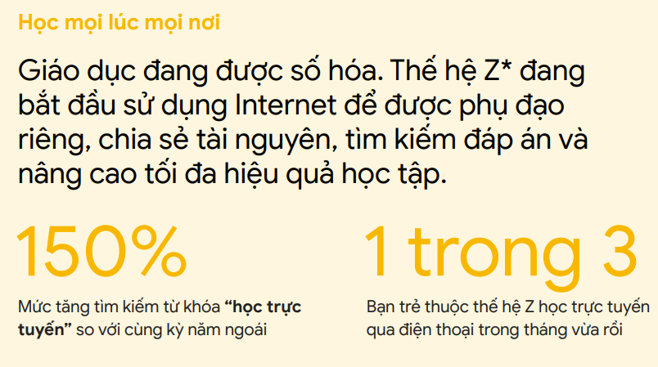
Market understanding
Market size
in US$ Billion
Learning aid
Document reader
Note-taking
Wiki
CAGR 16.4%
Knowledge base platform
Document collaborator
Personal information manager
“A second brain for you, forever”
3.21 (IAP) + 0.15 (Paid app) + 5.91 (Advertising)
Demand-side economy
Key Players
Google (US)
Apple (US)
Microsoft (US)
Evernote (US)
Notion (US)
Milanote (Australia)
Dropbox (US)
Typora (China)
No restrictions on law or government
Global scope development potential
Note Taking App Market - Global Industry Analysis and Forecast (2022-2029) - MMR
Vietnam’s Search for Tomorrow – Google Vietnam
Notes:
Simples is best, less is more

Slide 12
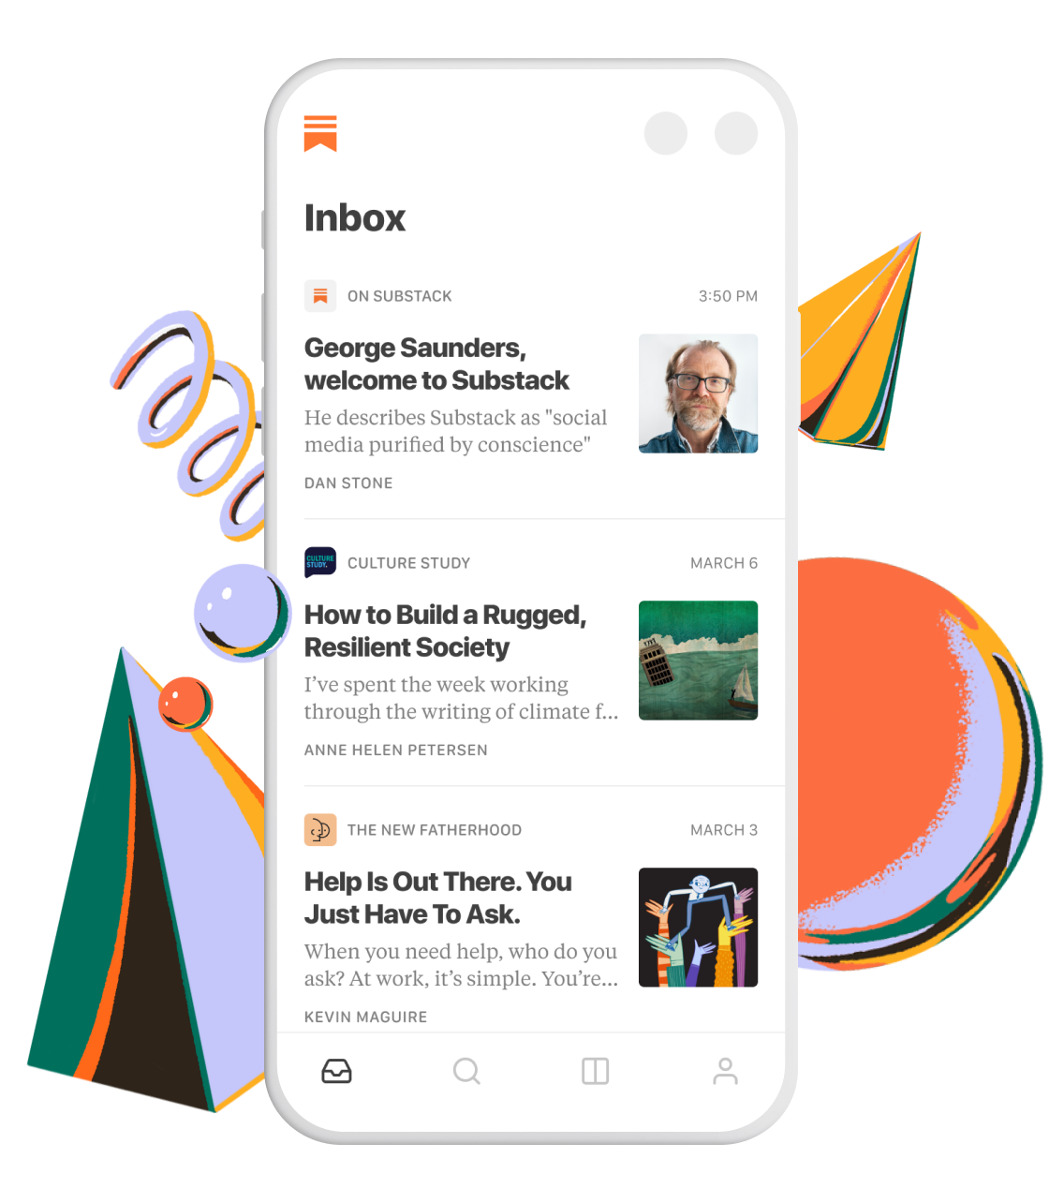



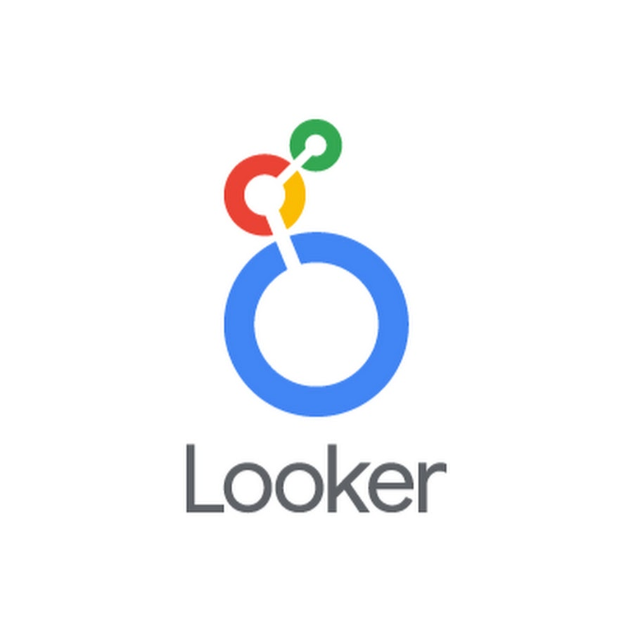

Market trend
Modularize into minor domain
Read
Meeting
Share images
acquired
Business Intelligence
Notes:
Simples is best, less is more

Slide 13
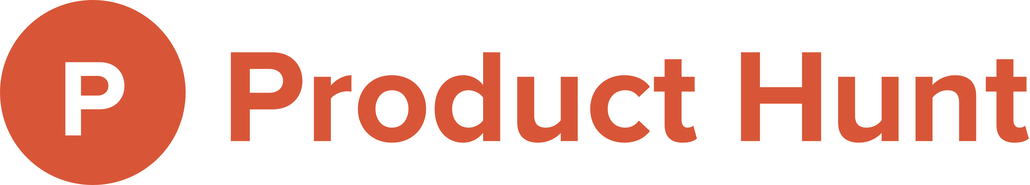
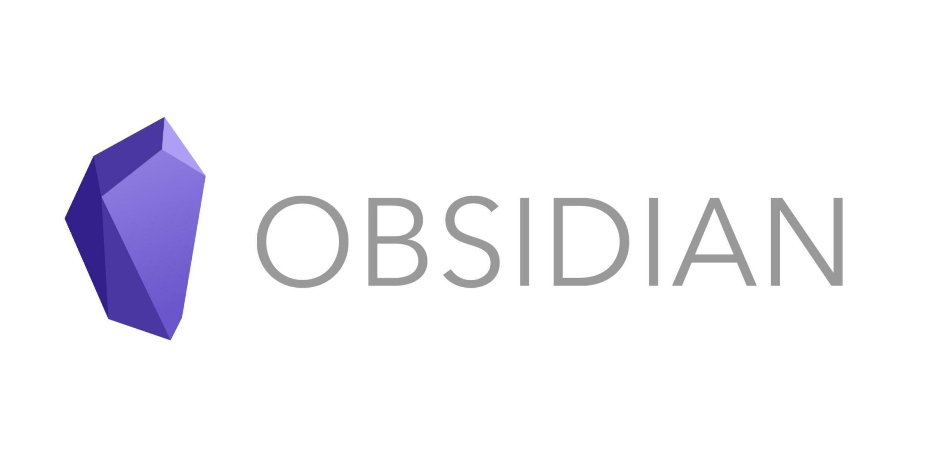
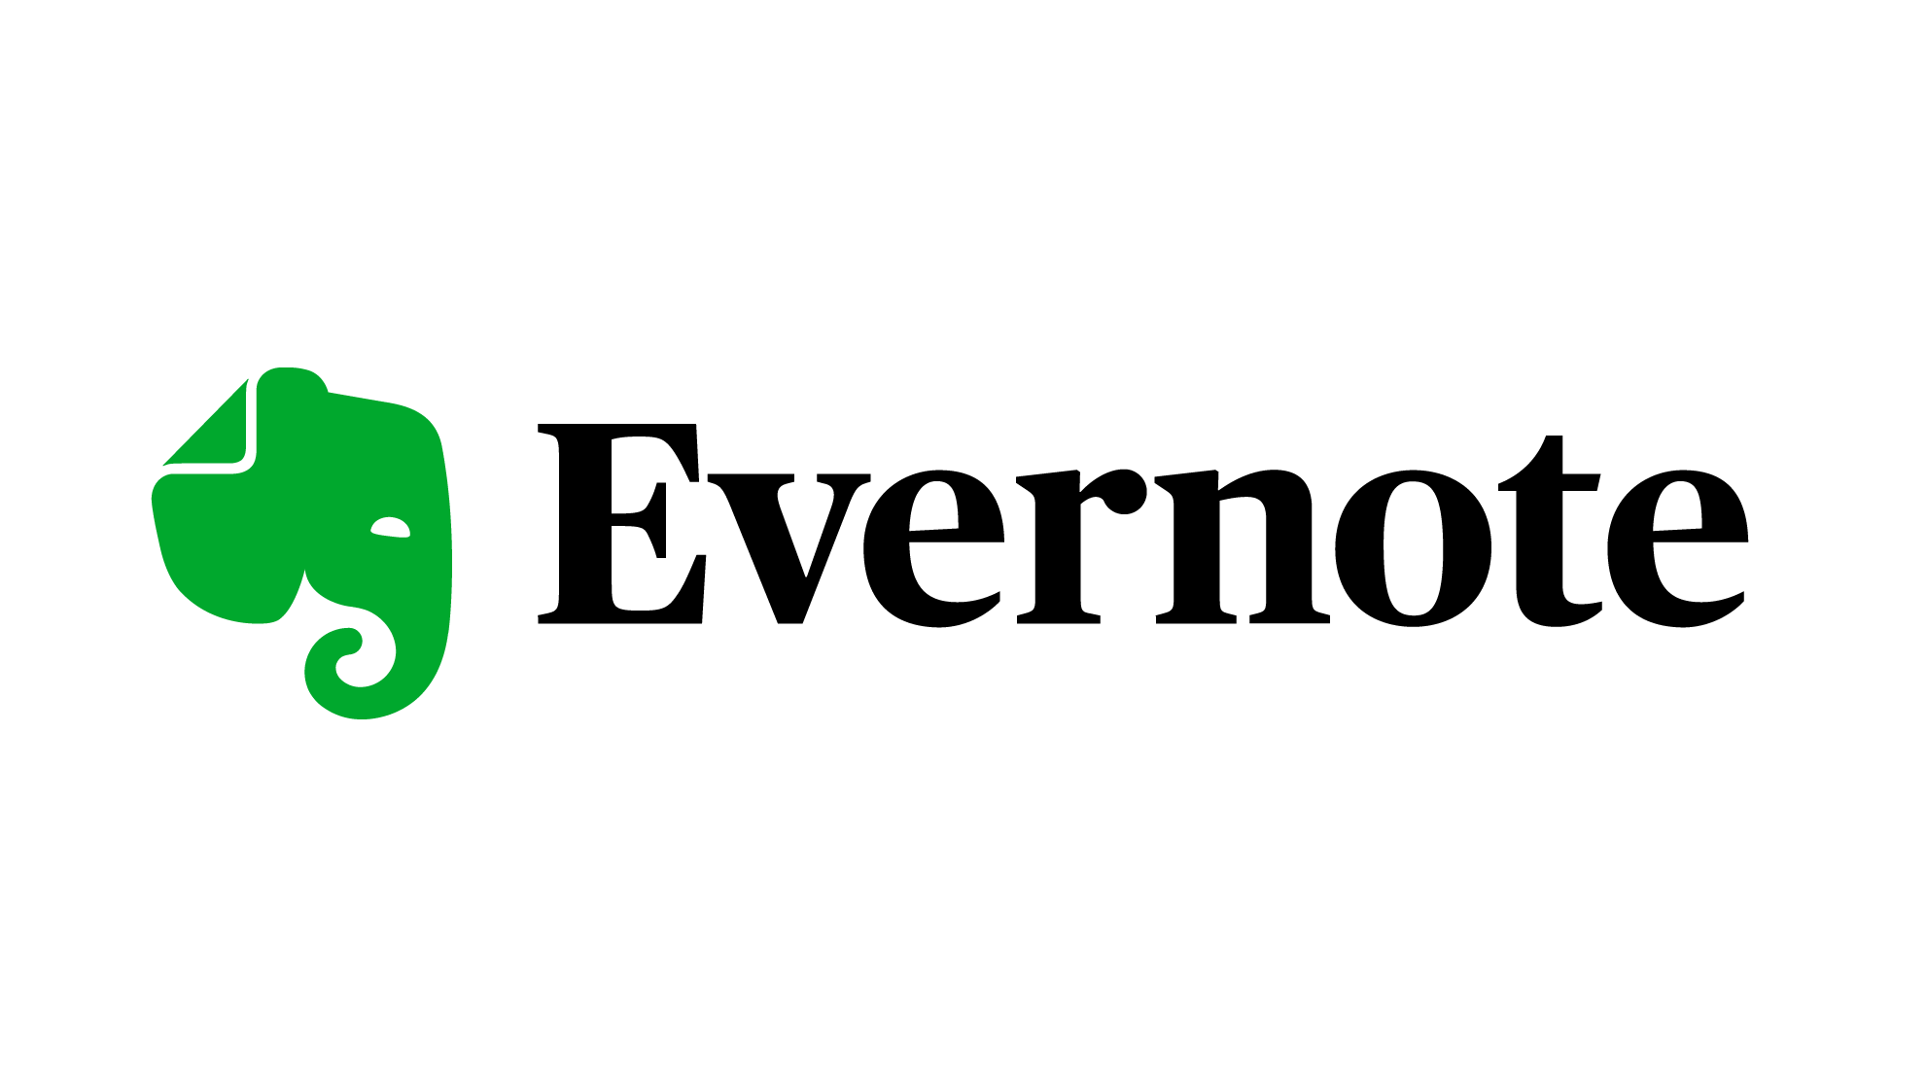





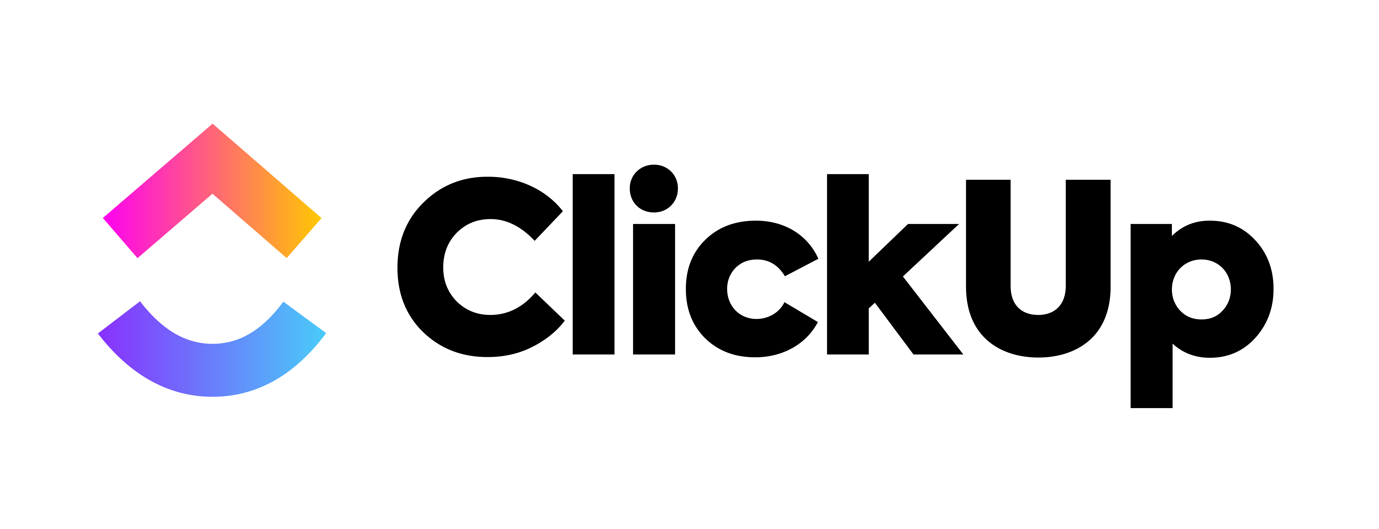
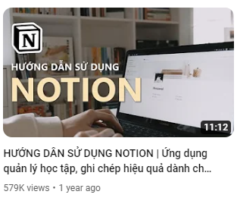
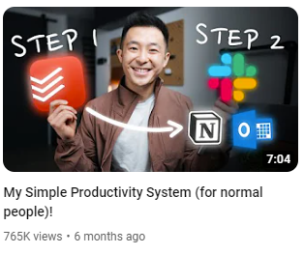
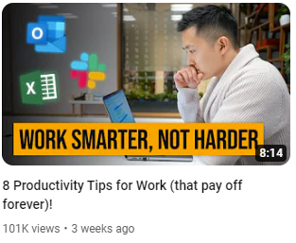
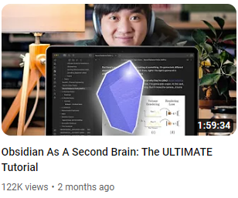
Market trend
Emerging productivity apps
“Time is most precious”
PRODUCTIVITY
The most views and engagement topics on
Notes:
Simples is best, less is more

Slide 14
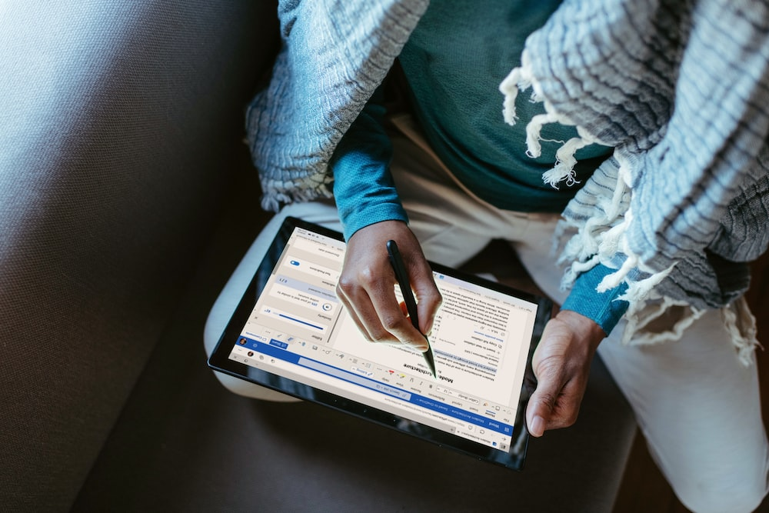
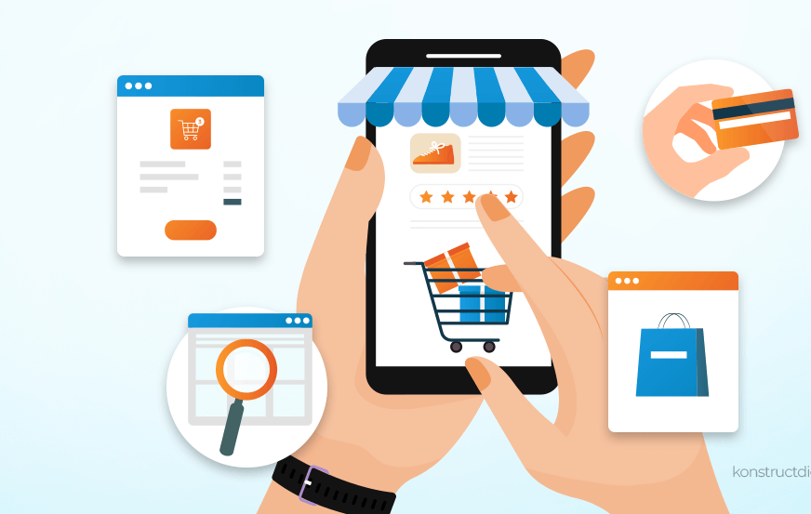
Market trend
From always-available to pre-planned experiences
Phygital reality
Physical and digital world collide
Craving convenience
Top 10 global consumers trends in 2021 - Euromonitor International
Notes:
Simples is best, less is more

Slide 15

Market demand
Figuring out a workflow
Difficulties in
Working process
Using support tool
They need a solution that
Easy to use, easy to learn
Time efficiency
Cost efficiency
Offline support
Sustainable process

Slide 16

Customer segmentation
Traditional learner
Hobby Learner – 24%
Self-directed learners
High school/University student, 18 – 24 year-olds
Prefer a hybrid method: digital, books, in-person
Passionate for learning in a conventional environment
Career learner – 19%
Prefer reading and listening over group study
Multigenerational learners
Prefer learning through digital
Reluctant Learner – 17%
25%
Have little passion for learning
Skeptical learner - 15%
Don’t think that school is for them
Traditional and Career learners are potential customers
- Pearson -

Slide 17




Customer segmentation
Behaviours
The architect
The gardener
The librian
The painter
Customization
Build their own
Love discovering
Connect ideas
Arrange neatly
Store & find later
Random
Quickly jot down
Occupation
Student
Engineer
Office worker
Lecturer
Scientist
Blogger
Writer
Researcher
and so on…
- Blog ThinhVu.com & TuanMon.com -

Slide 18

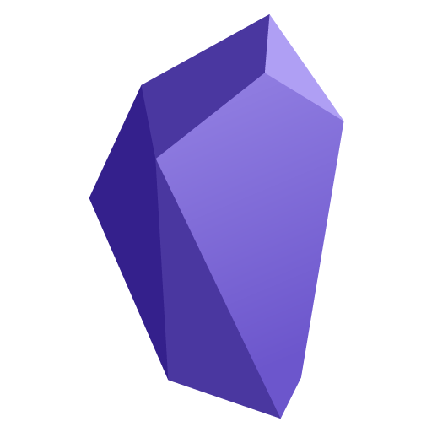





Competitors Note-taking domain
 | Notion | Obsidian | Evernote | GoodNotes | Tetu
Price | Freemium (8$) | Free | Freemium (1.5$) | $7.99 | Freemium (1.5$)
Market share | 73.48% | - | 0.5% | - | -
Platform
Offline support | No | Yes | No | Yes | Yes
Markdown support | Yes | Yes | No | No | Yes
Organization level | High, linear | High, non-linear | Limited, linear | Medium, linear | High, non-linear
Customization level | High | High | Low | Medium | High
Total visits | 429.3M | 4.0M | 28.3M | 1.4M | -
Community | 1M+ | 100K+ | 706K+ | - | -
- SimilarWebs.com -

Slide 19



Competitor
Learning by reading domain
 | eJOY | News in Level | Lingua Notes | Tetu
Price | Freemium (7$) | Free | Freemium (3$) | Freemium (1.5$)
Platform
Features | - Look up new words while reading - Audio reader - Access to latest news - Paragraph translation | - Read news everyday and learn new words - Review vocab | - Create note - Translate - Create exercise from note | - Read articles/news - Learn a word/grammar from paragraph - Create personal dictionary - Build exercise/flash card for revision
However, these apps lack connectivity to the note taking tool and only solve a micro problem of users

Slide 20

SWOT analysis
Strengths | Weakness
- New, unique idea, meeting a popular painpoint today - Productivity topic is getting more and more popular - Many sample business model/apps for research and reference | - Limited technical expertise to implement - Lack of connections with industry experts
Oppounities | Threats
- Innovation trend is being promoted by the state and enterprises - Global product potential - Strong market demand for personal work solutions | - Many users have formed habits and are loyal to a number of previous appa - The user community of exist apps are substantial and devoted
Focus on our USP and utilize digital marketing to spread quickly at the initial stage.

Slide 21

THANK YOU!
If you have any questions?
Don’t hesitate to ask us
or contact us
dolphin.team111@gmail.com
DolphinGroup

